Slide 1
ETRI 6G 운영위원회(5차, 22년 3차)
6G 원천기술 후보
2022. 7. 14.
네트워크연구본부
Notes:
발표를 시작하겠습니다.

Slide 2
6G 원천기술 목록 개요
원천기술명 | 제안자 | 특허 출원 여부
종단간 초정밀 네트워크 기술 개발
Tbps급 광통신 인프라 기술 개발
지능형 6G 모바일 코어 네트워크 기술 개발
Cloud-Native 6G 모바일 코어 네트워크 기술 | 타이광퉁 | 8월 예정

Slide 3
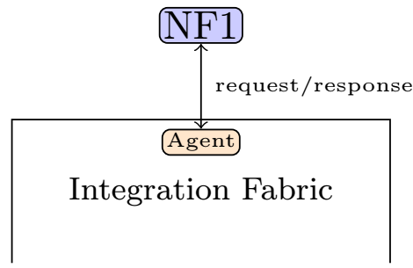
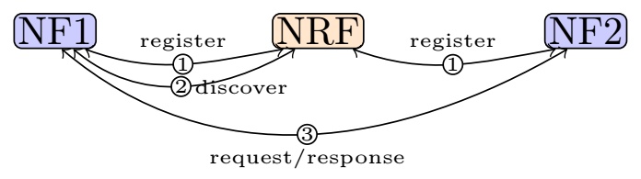
Cloud-Native 6G 모바일 코어 네트워크 기술(1/4)
Cloud-native 5G issues :
Current architecture includes both mobile application network functions and service discovery/routing functions in the signaling network
Complex signaling procedures within network functions due to the mixing of service discovery/service selection
Centralized service discovery (bottleneck at NRF), high latency
Prevent innovative approaches for service discovery
Our solution :
Clear separation between data plane and control plane in signaling network
Data plane: service – service interactions
Control plane: configuring routes among services
Service discovery/routing is implemented in a blackbox (integration fabric/service mesh) with simple APIs toward the network functions.
Simplify signaling procedures within network functions
Enable different kinds of service discovery

Slide 4
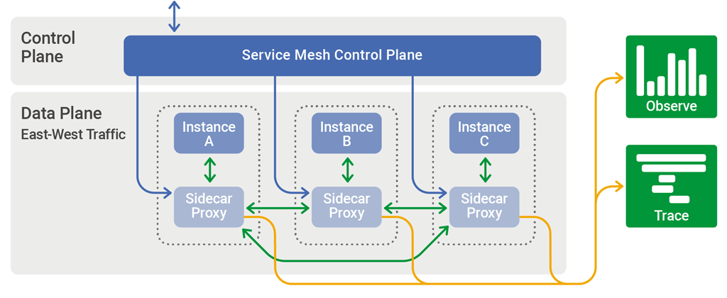
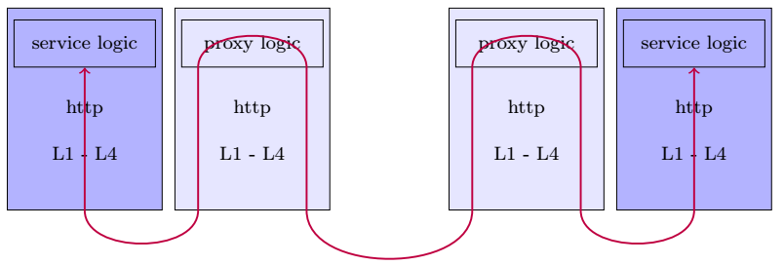
Cloud-Native 6G 모바일 코어 네트워크 기술(2/4)
Current service mesh solution
Sidecar proxy is an independent application
Incur latency due to more processing hops
In current service mesh: service routing by names:
find an instance of a service named http://example.com/web/backend
In 5G:
find and AMF that can serve slices A,B and C (difficult to realize with current service mesh)

Slide 5
Cloud-Native 6G 모바일 코어 네트워크 기술(3/4)
Invention description :
The invention creates a service mesh of mobile core network functions. The mesh allows a network function can request a service from another network function by its name and description without knowing its location. The two network functions can be either in the same domain or in a different domain.
The service mesh consists of a service controller and service agents. A service agent lives within a network function. Through the controller, agents learn each other locations which help them to direct service requests/responses to appropriate destinations.
Domain 1
Domain 2
Control plane
Service Controller
Service Controller
node
Cluster
Cluster
node
node
node
node
node
node
pod
pod
node
pod
pod
pod
pod
Data plane
AMF
SMF
Gateway
Gateway
UDM
UDR
Service agent
Service Agent
Service Agent
Service Agent
Service agent
Service Agent

Slide 6
Cloud-Native 6G 모바일 코어 네트워크 기술(4/4)
독창성 :
A clear separation of control plane and data plane in mobile core signaling network
Distributed service registry
Essential complementary features (security, policy enforcement, telemetry) for the mobile core network can be implemented at the service agents
(핵심성) Enables reliability, scalability, secured deployment of multi-domain network slicing
(혁신성)
Moving operational related features to service agent can simplify network function business logic which fosters the quick development of new applications.
Service mesh and network functions can be developed independently
Service Broker
Policy Manager
Security Manager
Telemetry Manager
Service Controller
Control Plane
Secure connection
Local Registry
Service Agents
Selection
Telemetry
Other Network Functions
Configuration
Forwarder
Data Plane
6G Network Function Business Logic
(AMF, SMF, UDM, etc.
Or Service Gateway)

Slide 7
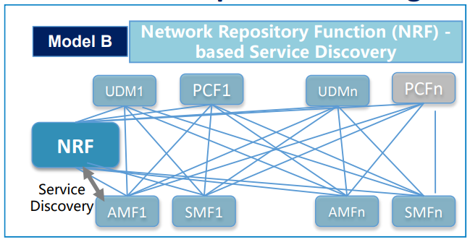
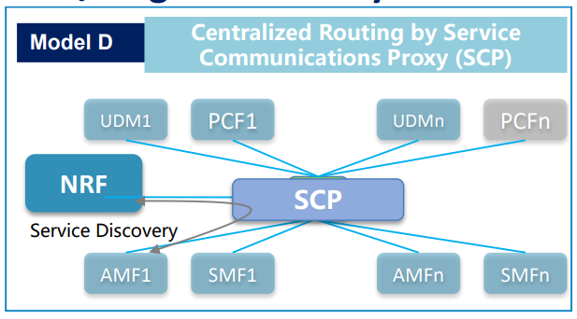
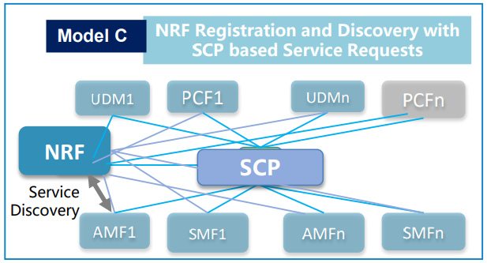
AMF1
PCF1
SMF1
SMF2
PCFn
)
Integration fabric
(service registration, discovery, selection, fault detection
AMFn
UDM1
UDMn
New NF
New NF
-unified APIs interface
- alternative service discovery methods
- no centralized NRF → no bottleneck
- no NRF-bound → free to add new NFs

Slide 8
Without SCP (TS 23.501 - model B)
With SCP (TS 23.501 - model D)
With an integration fabric
NF
NRF
NF
SCP
NRF
NF signaling logic
Agent
register
register
start agent
ack
ack
agent object
nf-query
request + nf-query
nf-query
Announce
Update registry
NF profiles
NF profiles
request + nf-query
request
Select NF
request
X
Select NF
request
Select NF
X
NF1
NF1
X
Agent1
request
request
request
response
response
NF2
response
response
Agent2
response
NF2
5G/6G scope
5G/6G scope
5G/6G scope
Integration Fabric
API call/return
Network function boundary
Complex signaling procedures
Vendor-lockin (load balancing, telemetry, security, fault recovery)
1 hop service delivery
NRF dependent
Bottleneck at NRF
Network delivery message
Simplified procedures
Unified Load balancing, telemetry, security, fault recovery
1 hop service delivery
No NRF, distributed registry (agents are registries)
Simplified signaling
Unified load balancing, telemetry, security, fault recovery
2 hops service delivery
NRF dependent
Bottle neck at NRF

